Slide 1

Q.4
Book Fair Quiz-2K25
“Nobody wants my soul, nobody wants my pain
To get moved by my tears and for me to surrender to them
Nobody wants my soul, nobody wants my pain
On my pillow, restlessly, I dream of evil
Till the end of time, till the world ends
My fate is cursed
This soul has no home, this soul has no tone
Candles of a black dawn are burning, my nightmares
My nightmares, my nightmares
My nightmares, my nightmares ”
This is the English translation of a Serbian song named Teya Dora by Džanum. Give me the specific term/reason by which we all know it better.

Slide 2
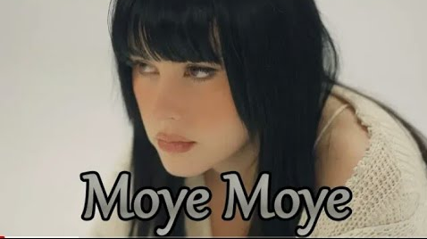
Q.4
Book Fair Quiz-2K25
The Meme: “Moye Moye”

Slide 3
Q.5
Book Fair Quiz-2K25
Deep Jwele Jaai (1959), a timeless Bengali classic directed by Asit Sen, is renowned for its profound storytelling and masterful performances. Starring the legendary actress Suchitra Sen and Basanta Choudhury, this psychological drama delves into themes of love, sacrifice, and mental health, with Suchitra Sen portraying Radha, a compassionate nurse in a psychiatric hospital.
The movie features an iconic song, X, sung by Y, one of the most celebrated figures in Indian music history. This song, pivotal to the evolution of Indian musical culture, is said to have introduced a groundbreaking innovation: the use of whistling as a musical element.
During the 1950s, Y was deeply inspired by Western music, particularly classical and soft melodies, and often experimented with unique elements to add a reflective or breezy quality to his compositions. Drawing from Western trends, Y incorporated whistling into the song X, making it a revolutionary piece in Indian cinema. This trailblazing song remains an iconic representation of artistic innovation and continues to enchant listeners to this day.
Identify X and Y.

Slide 4

Q.5
Book Fair Quiz-2K25
ANS RESOURCE

Slide 5

Q.5
Book Fair Quiz-2K25
X: “Ei Raat Tomar Amar” Y: Hemanta Mukhopadhyay a.k.a Hemant Kumar

Slide 6


Q.6
Find A Way Or Make It
X is a masterpiece anime movie by Makoto Shinkai, a renowned mangaka. The movie features a 17 year old girl, X, who stumbles upon a mysterious man Souta who was searching for doors. But she later accidentally opens one of them, unleashing a wave of supernatural power which could potentially destroy Japan.
So to fix her mistake she embark on a journey which was portrayed in the film. This movie also had a nomination for the Golden Globe Awards in the Best Motion Picture's category. Also it has won Japan Academy Film Prize 2023 in the category of Best Music Score for its theme song by RADWIMPS and Kazuma Jinnouchi.
Id X.

Slide 7
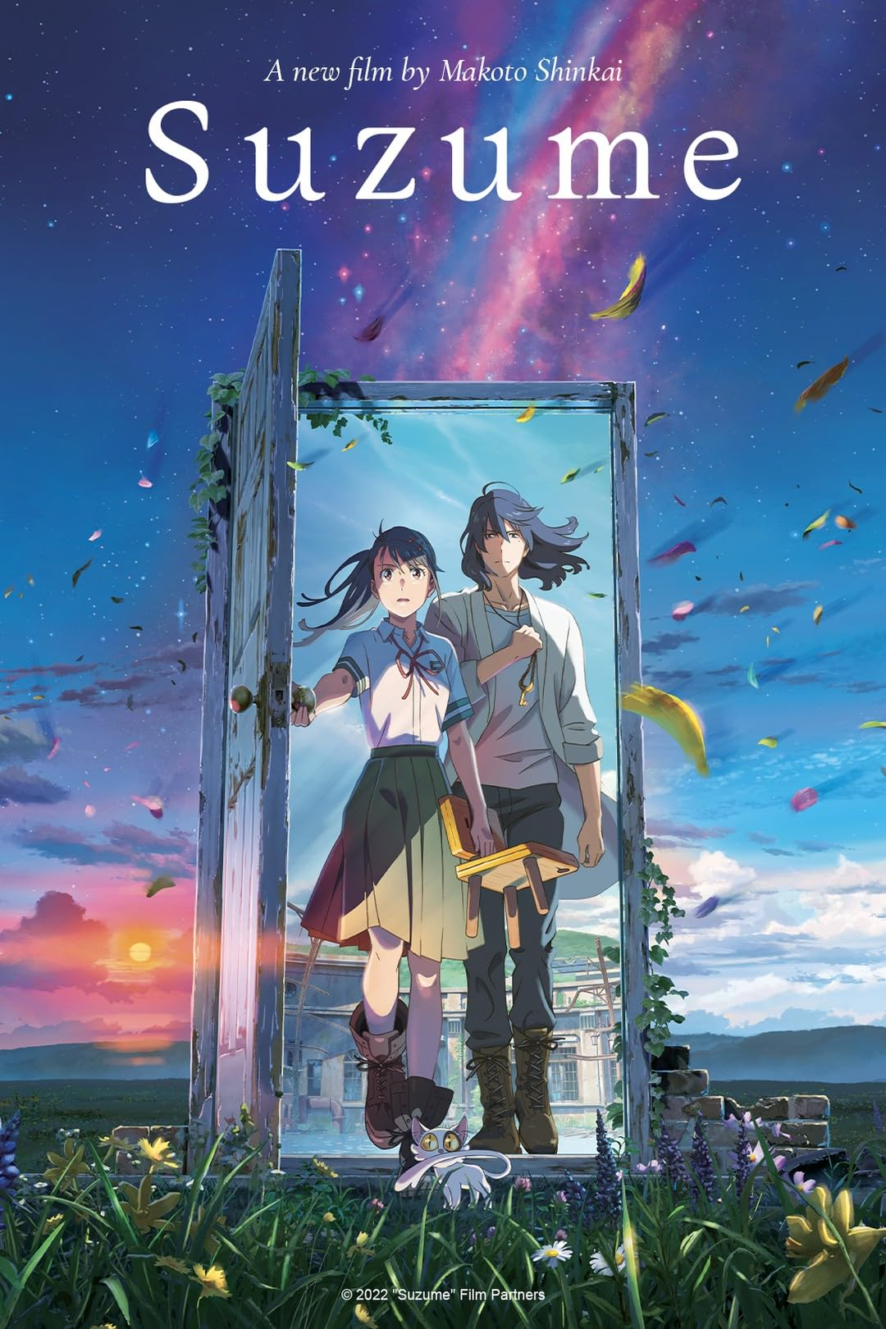
Q.6
Find A Way Or Make It
X: Suzume (2022)

Slide 8
Q.7
Book Fair Quiz-2K25
This is a movie of Kishore Kumar. A very popular internet meme resembles the dialogue of this film.
Identify the meme

Slide 9
Q.7
Find A Way Or Make It
Cheen Tapak Dum Dum

Slide 10
Q.8
Book Fair Quiz-2K25
The alternative used had lead, which clogged the electrical points inside and was also hazardous to human health. So Paul C. Fisher decided to develop ________,which could be used instead.
He developed a pressurized cartridge with refill which had thixotropic properties and remained semisolid until the shearing action of the rolling ball inside liquefied it.
The cartridge was pressurized with nitrogen so that it didn't rely on gravity. It was reliable in the cold and the heat. All this was made fun of in a movie.
Give me the movie and the invention.

Slide 11
Q.8
Find A Way Or Make It
3 Idiots, Space Pen

Slide 12
Q.9
Book Fair Quiz-2K25
Recently a song has become very famous in India as well as around the globe. The song X one of the songs of the movie Y released in 2024.
The historical drama film Y is directed by Siddhart P Malhotra and produced by YRF Entertainment. The film is based on the Y Libel Case of 1862 and Saurabh Shah's novel about the case. It is streaming on Netflix.
The song X is a romantic song where a girl is trying express her love by singing the song. She's proposing his love to say yes in a very unique manner
In the song she says:
"Come, let’s toss the coin of our story.
If it’s heads, I’m yours; if tails, you belong to me."
She continues her cute approach by giving her love the option to say "Yes or Yes?".
The song is sung by a famous Bengali singer and it has secured a place on the top 10 trending songs' list in India on Spotify.
Guess X and Y

Slide 13
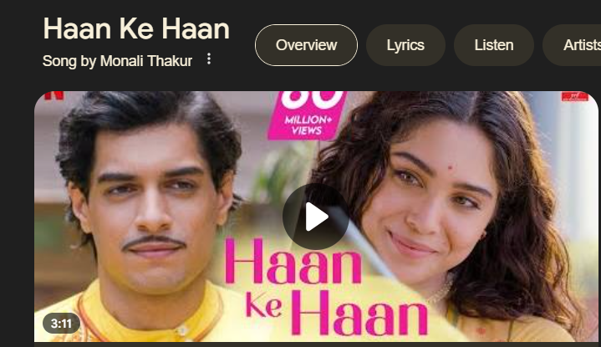
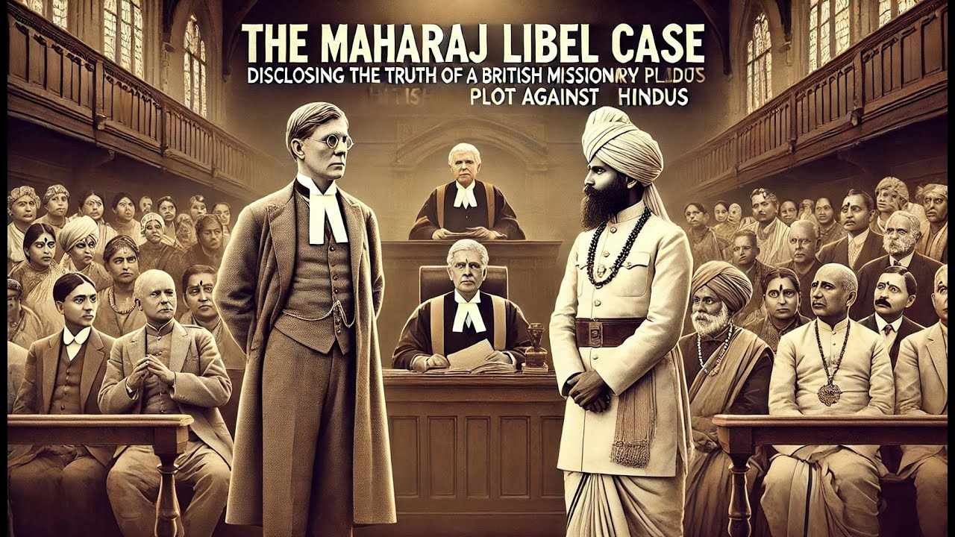
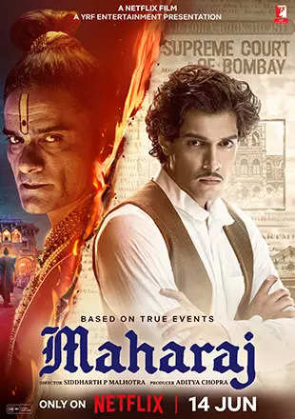
Q.9
Find A Way Or Make It
X: Haan Ke Han (Sung by Monali Thakur)
Y: Maharaj

Slide 14
Q.10
Book Fair Quiz-2K25
X is a legendary Punjabi pop song by Y, released in 1998. It became a global phenomenon due to its catchy beats, upbeat energy, and Y's dynamic performance.
Interestingly, Y created X to prove his music could stand on its own, after facing criticism that his success was due to glamorous models in his videos. The music video, made with a ₹2.5 crore budget, was the first in India to use bluescreen technology, allowing Y to appear over computer-generated backgrounds like deserts, mountains, and St. Basil's Cathedral.
The music video follows a simple plot about four men, all played by Y, who represent the four classical elements and dress in lavish Indian clothing. The earth Y wears red/maroon, the fire Y wears orange, the wind Y wears brown, and the water Y wears green. The men start off as comets made of water, earth, air, and fire before transforming into clothed Y. Each of the Y take turns singing, dancing and pointing at each other as though they are discussing something. The Y later fuse by first reverting to their comet states and then merging to form one big Y, who is predominantly clad in garb of gold and emerald. The song became his biggest hit and remains a meme-worthy classic to this day.
It’s also super popular in gaming and internet culture, with fans around the world loving the quirky vibe.
Guess X and Y

Slide 15

Q.10
Book Fair Quiz-2K25

Slide 16
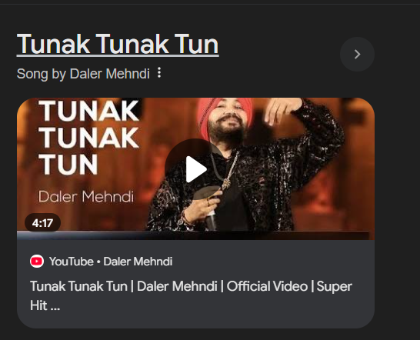

Q.10
Book Fair Quiz-2K25
X: Tunak Tunak Tun
Y: Daler Mehndi

Slide 17
Q.11
Book Fair Quiz-2K25
X, a romantic musical drama directed by Mohit Suri, shares thematic parallels with La La Land (2016), an Oscar winning film, in its portrayal of love, ambition, and sacrifice.
Starring Aditya Roy Kapur and Shraddha Kapoor, the film follows Rahul Jaykar, a troubled singer battling alcoholism, who discovers and mentors Aarohi Shirke, a talented singer striving for stardom. As their love deepens, Rahul's personal struggles threaten their relationship, leading to a heartbreaking sacrifice where Rahul steps away—much like how La La Land explores the bittersweet choice between love and career.
Known for its soulful soundtrack , X , mirrors La La Land's emotional depth, emphasizing how love and ambition often collide, leaving an enduring impact on both characters' lives.
The movie has also become famous for its hit soundtrack Y sung by a leading talent then which later became a pivotal figure of the Indian music industry.
Id X and Y

Slide 18
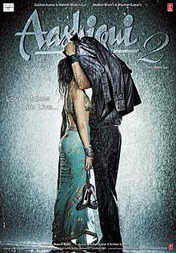
Q.11
Book Fair Quiz-2K25
X: Aashiqui 2 (2013)
Y: Tum Hi Ho

Slide 19
Q.12
Book Fair Quiz-2K25
In ancient times, war was a common occurrence, and the Greeks invented a special kind of dress, X, for soldiers, designed to enable free movement during battle. X proved to be practical, comfortable, and easy to produce at a time when weaving techniques were simple and resources were limited. Its short, tunic-like structure allowed warriors to move their legs freely, making it ideal for combat situations, particularly in the rugged terrains of Greece.
In hot climates, this garment provided excellent ventilation, keeping the soldiers cool, while its simple design ensured ease of wearing and durability in harsh conditions. Beyond its practicality, X and similar garments symbolized power, status, and identity in various cultures. For example, the Egyptian shendyt, the Roman toga, and later the Scottish kilt served as symbols of pride and prestige for men, often denoting social rank or cultural heritage. Such garments were also widely used in religious ceremonies, worn by priests, leaders, and figures of authority, emphasizing their significance beyond the battlefield.
Over time, as Western cultural norms evolved, garments like X became associated with women. However, historically, they were respected and functional attire that played a vital role in the lives of men, particularly soldiers, workers, and leaders. For data, this type of clothing was also favored for its ease of mass production, requiring minimal material and simple tailoring, which made it ideal for outfitting large groups such as armies or labor forces efficiently and economically.
Id. X

Slide 20
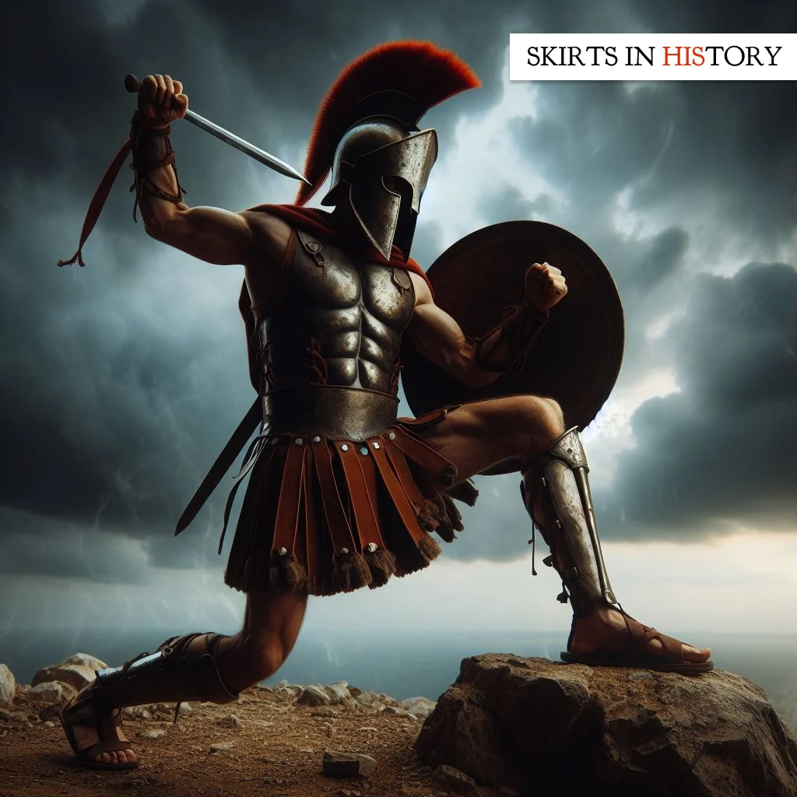
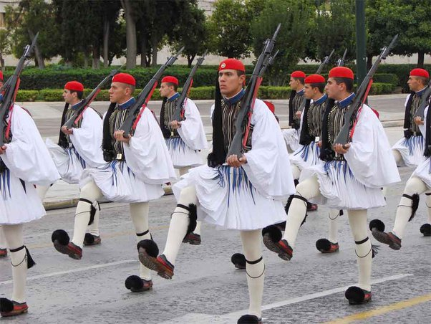
Q.12
Book Fair Quiz-2K25
Skirt

Slide 21
Q.13
Book Fair Quiz-2K25
Johnny Weissmuller, one of the finest competitive swimmers of the 20th century, was a winner of 5 gold medals in freestyle swimming and a bronze in Water Polo, won in the Paris and Amsterdam Olympics in 1924 and 1928. He was decorated with 67 records in this duration. Subsequently, Weissmuller turned his attention to modelling and movies. One of his popular roles included that of Jungle Jim .
Which other character did he immortalized by featuring as the same in 12 movies.

Slide 22
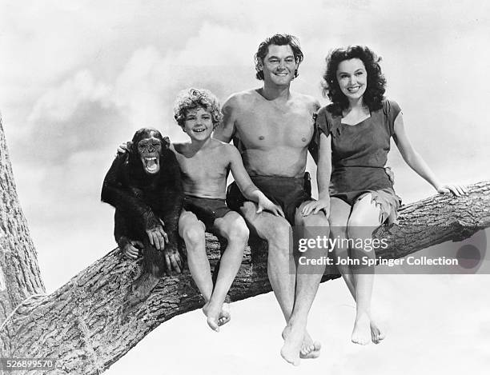
Q.13
Book Fair Quiz-2K25
Tarzan

Slide 23
Q.14
Book Fair Quiz-2K25
In the early 20th century, with the rise of household appliances, a specific term, X, became popular which has now become a de-facto nickname for the word “refrigerator”.
X, which referred to an essential cooling device, included an unexpected additional letter in its spelling. This letter, absent from the original word, was likely inspired by similar words that made the term easier to pronounce and remember. Interestingly, the popularity of X was also influenced by a major appliance brand of the time, Y. The company became a household name, leading many people to associate refrigerators with this brand. Over time, X evolved into the go-to informal word for this essential device, reflecting how language is shaped by technology and branding.
Id X and Y

Slide 24
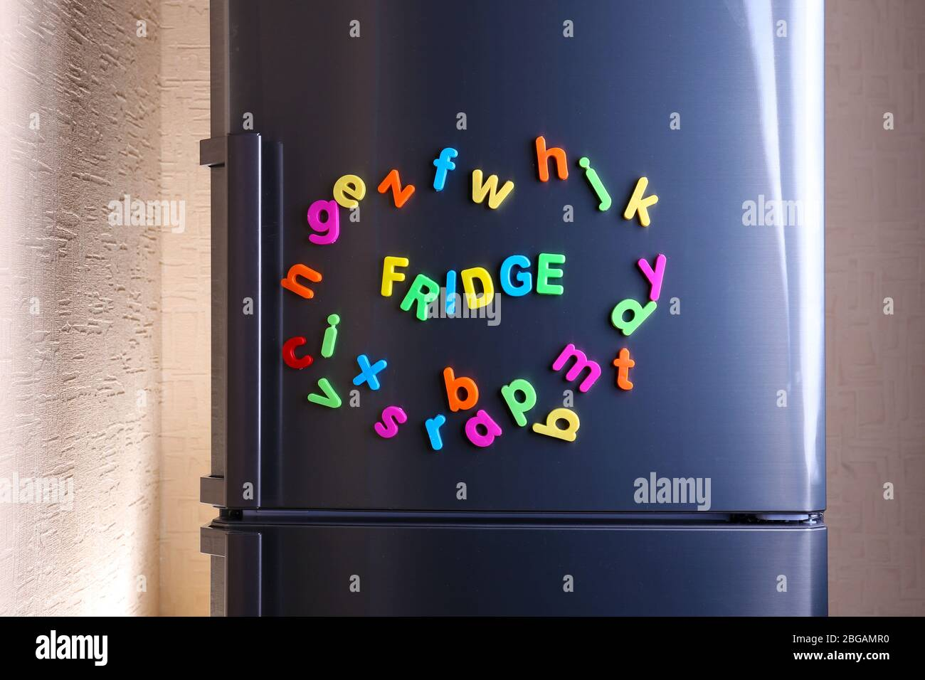

Q.14
Book Fair Quiz-2K25
X: Fridge
Y: Frigidaire

